Slide 1


Building a Multi-Level Validation Framework for KG
Nilesh Gupta
(25CS60R64)
Department of Computer Science and Engineering
Indian Institute of Technology, Kharagpur

Slide 2
Motivation
Why Knowledge Graph Validation Matters?
Knowledge Graphs constructed from LLMs and scientific literature often contain:
Hallucinated triples
Incorrect relations
Ontology inconsistencies
Unsupported scientific claims
Duplicate and noisy entities
Weak reasoning paths
Key Question
How can we automatically validate extracted knowledge before inserting it into the Knowledge Graph?

Slide 3

Proposed Validation Framework
Phase 1: Extraction & Grounding
1. Scientific Papers
2. Ontology-Aware Extraction
3. Local Citation Grounding
Phase 3: RAG Retrieval & Validation
5. Multi-Doc Retrieval
6. Evidence Reranking
7. LLM Evidence Validation
Phase 5: KG Construction
10. Knowledge Graph Construction
11. Reasoning Path Generation
12. Reasoning Path Validation
Phase 2: Validation
4. Structural + Ontology
Phase 4: Evidence Scoring
8. Cross-Doc Evidence Fusion
9. Global Confidence Scoring

Slide 4
Stage 1: Ontology-Aware Triple Extraction
Triple Extraction from Scientific Literature
Input
Scientific PDFs
Research papers
Domain literature
Objective
Convert unstructured scientific text into structured knowledge tuples.
Example
(Pesticide Exposure | increases | Oxidative Stress)

Slide 5
Stage 2: Local Citation Grounding
Attach provenance information directly from the source paper during extraction.
Stored Citation Metadata
Supporting sentence
Paragraph
Section
DOI
Paper title
Page number
Example
Triple : (Pesticide Exposure | increases | Inflammation)
Evidence : “Chronic pesticide exposure induces inflammatory responses…”

Slide 6
Stage 3: Structural + Ontology Validation
Objective
Remove malformed and logically inconsistent triples before graph insertion.
Structural Validation
Ontology Validation
Checks Performed
missing entities
invalid tuple structure
empty relations
Invalid Example:
(Pesticide Exposure | | Oxidative Stress)
Purpose
Ensure triples satisfy domain ontology constraints.
Validation Types
Entity Type Validation
Pesticide → Chemical | Parkinson Disease → Disease
Domain-Range Validation
causes(Chemical, Disease)
Invalid Example:
(Parkinson Disease | causes | Pesticide)

Slide 7
Stage 4: Scientific Multi-Document Retrieval
Core Idea
Retrieve supporting evidence from multiple scientific papers to validate knowledge graph triples.
Data Sources
Why Multi-Document?
Primary Repositories:
PubMed
Semantic Scholar
Scientific corpora
Domain-specific repositories
Mitigating Single-Paper Risks:
Weak evidence
Uncertain findings
Incomplete conclusions
Cross-verification improves scientific reliability and robustness.

Slide 8
Stage 5: Evidence Reranking
Problem
Solution
Retrieved documents may contain:
noisy passages
irrelevant chunks
weak semantic matches
Rerank evidence using:
semantic similarity
ontology relevance
scientific context
relation alignment
Benefit: Improves quality of evidence passed to the validator model.

Slide 9
Stage 6: LLM Evidence Validation
Objective: Assess whether retrieved scientific evidence locally supports or contradicts the extracted triple
Validation Input
Validator Tasks
Evidence-Level Assessment
Triple
(Pesticide Exposure | increases | Oxidative Stress)
Evidence
Retrieved scientific passages from multiple papers.
verify evidence support
detect contradictory evidence
evaluate semantic consistency
assess scientific plausibility
Locally Supported
Locally Contradicted
Insufficient Evidence
Importance: Final scientific confidence is estimated later using cross-document evidence fusion.

Slide 10
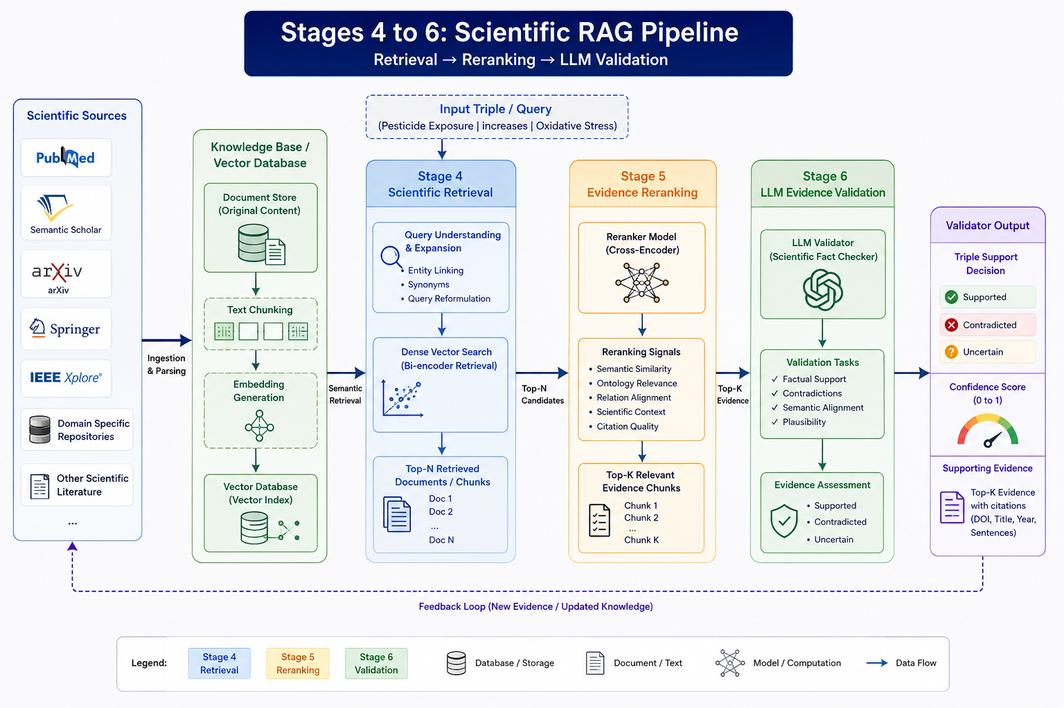

Slide 11
Stage 7: Cross-Document Evidence Fusion
The Standard RAG Pipeline
Limitations & Bottlenecks
Standard RAG (Multiple Papers)
↓
Retrieved Chunks
↓
LLM Prompt Context
↓
Generated Answer
Aggregation happens inside prompt context
Evidence relationships are temporary
Contradictions are not explicitly modeled
No persistent confidence representation
Key Observation
RAG retrieves evidence from multiple papers, but does not explicitly maintain structured multi-document evidence representations.

Slide 12
Stage 7: Cross-Document Evidence Fusion (cont)
Proposed Fusion Framework
Fusion Operations
Multiple Papers
↓
Evidence Validation
↓
Entity & Relation Alignment
↓
Contradiction Analysis
↓
Confidence Aggregation
↓
Structured Evidence Representation
Entity normalization
Relation alignment
Duplicate evidence merging
Contradiction detection
Evidence accumulation
Goal: Estimate scientific reliability using aggregated evidence across documents..

Slide 13
Stage 7: Cross-Document Evidence Fusion (cont)
Standard RAG | Cross-Document Fusion
temporary aggregation | persistent evidence representation
prompt-based reasoning | structured evidence modeling
implicit support estimation | explicit confidence scoring
no contradiction tracking | contradiction-aware fusion
answer generation focused | scientific validation focused
Example:
Paper A → support score = 0.91
Paper B → support score = 0.88
Paper C → contradiction score = 0.32
Relation:
Pesticide Exposure → Oxidative Stress
Support Count = 2
Contradictions = 1
Consensus Score = 0.84
Supporting Citations = [...]

Slide 14
Stage 8: Global Confidence Scoring
Objective
Assign a final confidence score using aggregated multi-document scientific evidence.
Conceptual Confidence Estimation
Example Application
Global Confidence =
Multi-Document Agreement
+
Semantic Alignment
−
Contradiction Strength
Relation
Pesticide Exposure → Oxidative Stress
Evidence Summary
Supporting Papers: 5
Contradictory Papers: 1
Strong Semantic Alignment
Ontology Validated
Final Confidence Score
0.91

Slide 15
Stage 9: Confidence-Aware KG Construction
Objective
Construct a reliable scientific knowledge graph using only validated and confidence-scored relations.
Stored Knowledge Representation
Benefits
(
subject,
relation,
object,
confidence_score,
supporting_evidence,
source_citations,
validation_metadata
)
Explainability
Logical rationale for every KG link
Traceability
Full provenance from source documents
Reliable Reasoning
Graph traversal filtered by confidence
Scientific Transparency
Clear evidentiary support mapping

Slide 16
Stage 10: Multi-Hop Scientific Reasoning
Objective
Discover indirect and hidden relationships across scientific literature using validated knowledge graph connections.
Example Reasoning Path
Applications
Pesticide Exposure
↓
Oxidative Stress
↓
Neural Inflammation
↓
Parkinson Disease
Hidden Relationship Discovery
Identify non-obvious scientific associations.
Cross-Domain Knowledge Integration
Connect agriculture, environment, and human health literature.
Hypothesis Generation
Suggest potential scientific relationships for further investigation.
Evidence-Aware Reasoning
Use only confidence-validated graph relations during traversal.

Slide 17
Stage 11: Validation of Reasoning Paths
Objective
Validate whether generated multi-hop reasoning paths are scientifically reliable and logically consistent.
Validation Example
Candidate Reasoning Path
Validation Observations
Pesticide Exposure
↓
Oxidative Stress
↓
Neural Inflammation
↓
Parkinson Disease
RelationConfidence
Pesticide → Oxidative Stress High
Oxidative Stress → Neural Inflammation High
Neural Inflammation → Parkinson Disease Moderate
Final Path Confidence: Moderate-High

Slide 18
THANK YOU
ANY QUESTIONS?

